Slide 1
ESTIMATION OF BUSINESS EXPENSES
1.Introduction:
overview Estimation is the scientific way of working out the approximate cost of an engineering project before
execution of the work.
• It is totally different from calculation of the exact cost after completion of the project.
• Cost estimation requires a thorough Knowledge of the construction procedures and cost of
materials & labour in addition to the skill, experience, foresight and good judgment.
An estimate of the cost of a construction job is the probable cost of that job as computed from plans and
specifications.
For a good estimate the, actual cost of the proposed work after completion should not differ by more than
5 to 10 % from its approximate cost estimate, provided there are no unusual, unforeseen circumstances.

Slide 2
Purpose : • • The Report Name is a 30-character length field. The first 20 characters of the Report Name appear on the Voucher Detail Expense Report in the Invoice ID field. It should include a general description that identifies the report so as to distinguish it from other reports (e.g., Prof Jones Nov 2011 Expenses, or Brown AMA Meeting). • The Business Purpose field at the report header level is a 64-character field. Information entered in this field does not appear on the Voucher Detail Expense Report. Because the individual expense lines on the report may not all be related, the information entered in the header business purpose field can be more generic in description, or tied to the largest expense purpose (e.g., General Business Expenses, or Conference Travel Expenses). Detailed business purpose information should be entered at the expense line level for each expense (see next bullet item). • Important! The Business Purpose field at the expense line level defaults from the report header and in most cases will not provide enough information about the individual expense to satisfactorily answer the 5 Ws described above. It is important that you review and overwrite the business purpose information that defaults in on each expense line to more clearly explain why the specific expense is necessary and appropriate

Slide 3
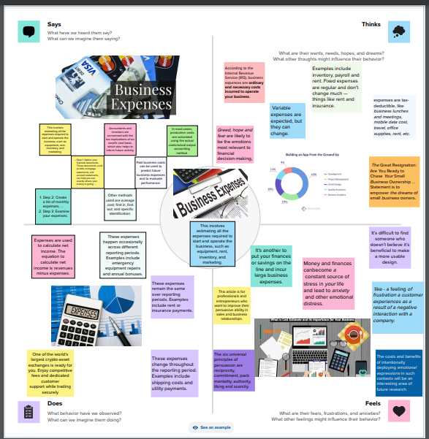
2.Problem definition & design thinking Empathy Map

Slide 4
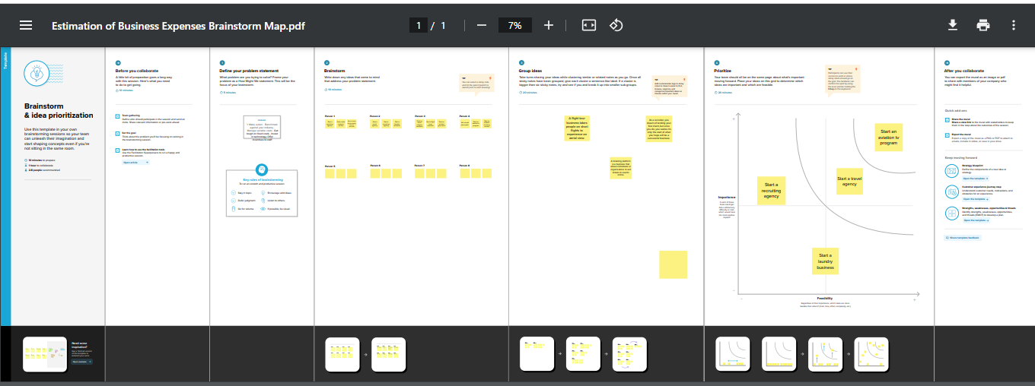
Ideation & Brainstorming Map

Slide 5
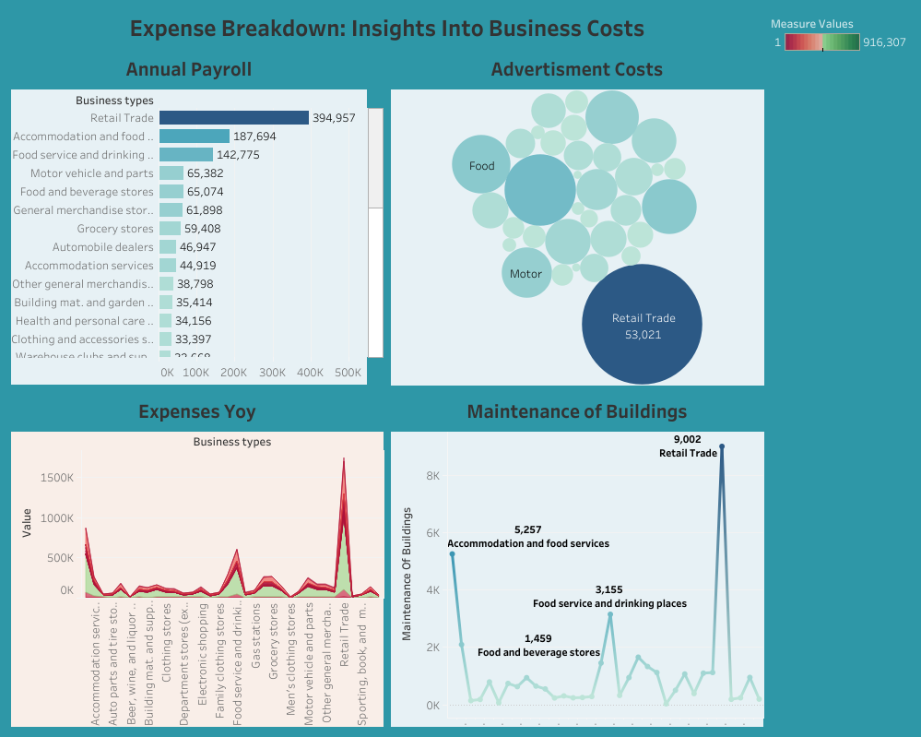
3. Result
dashboard

Slide 6
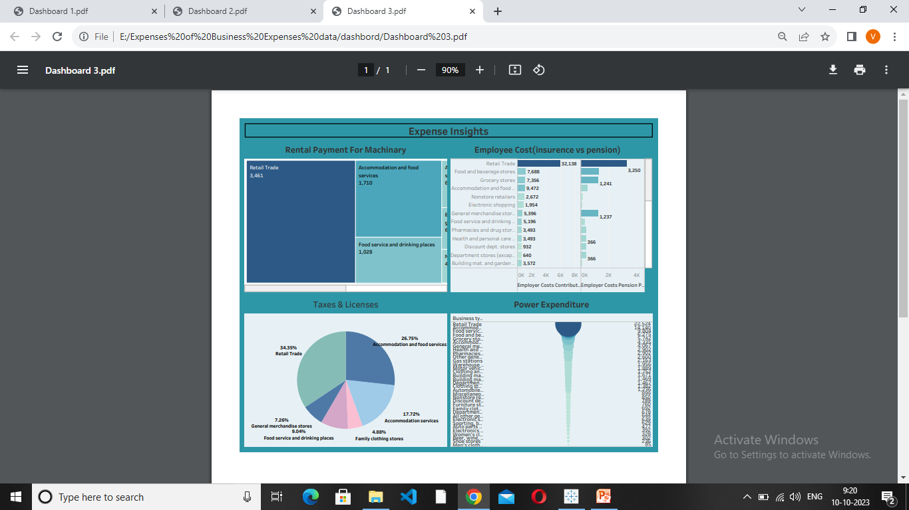

Slide 7
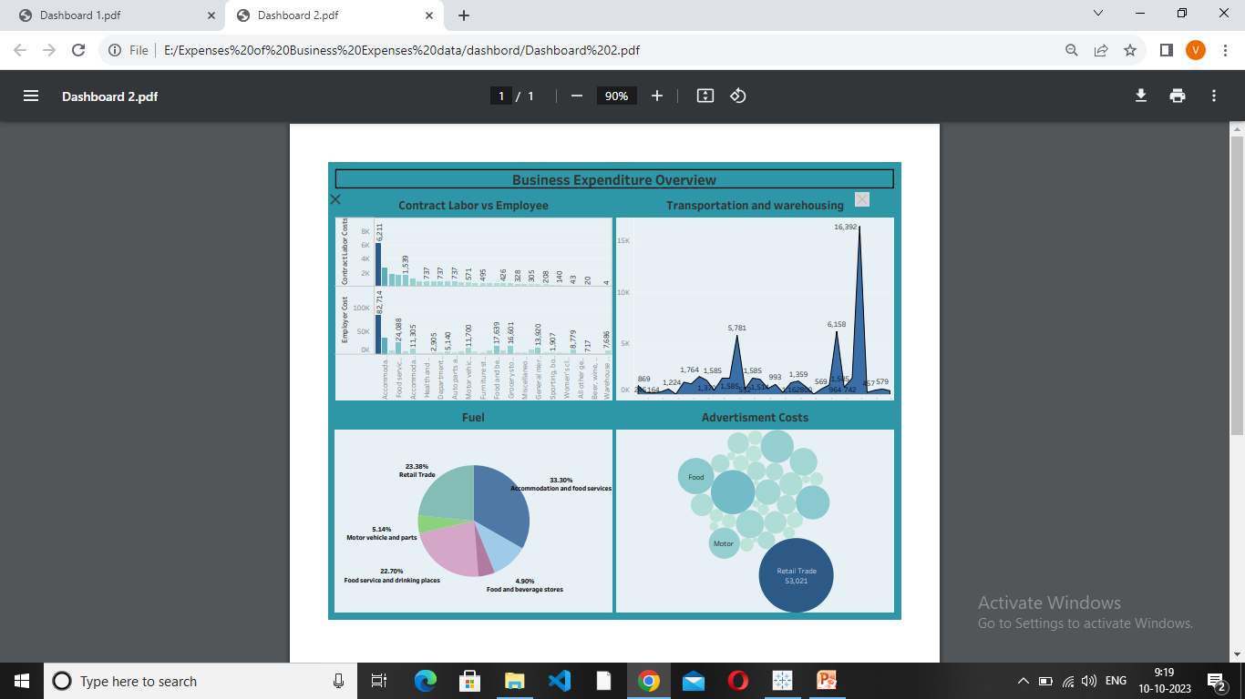

Slide 8
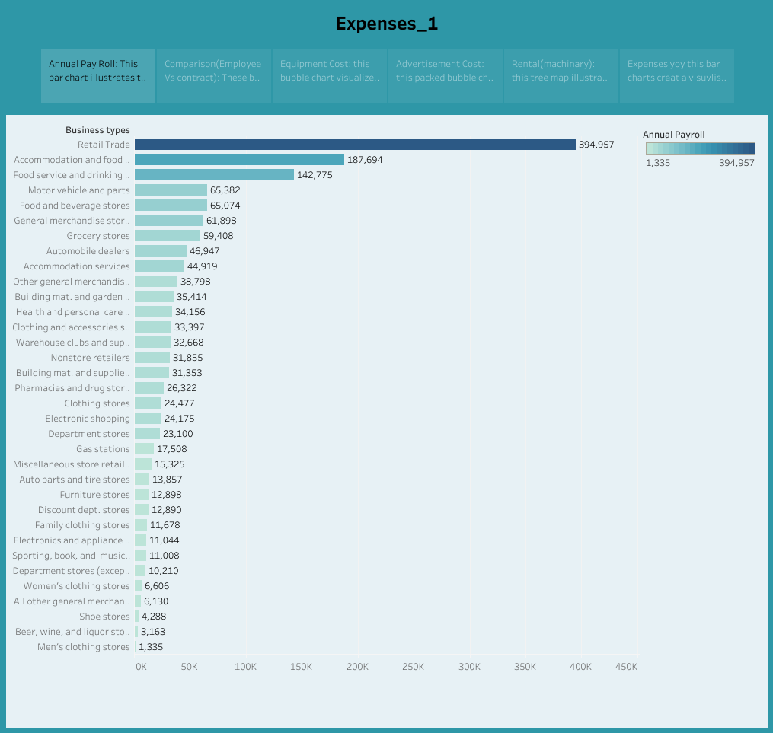
story

Slide 9
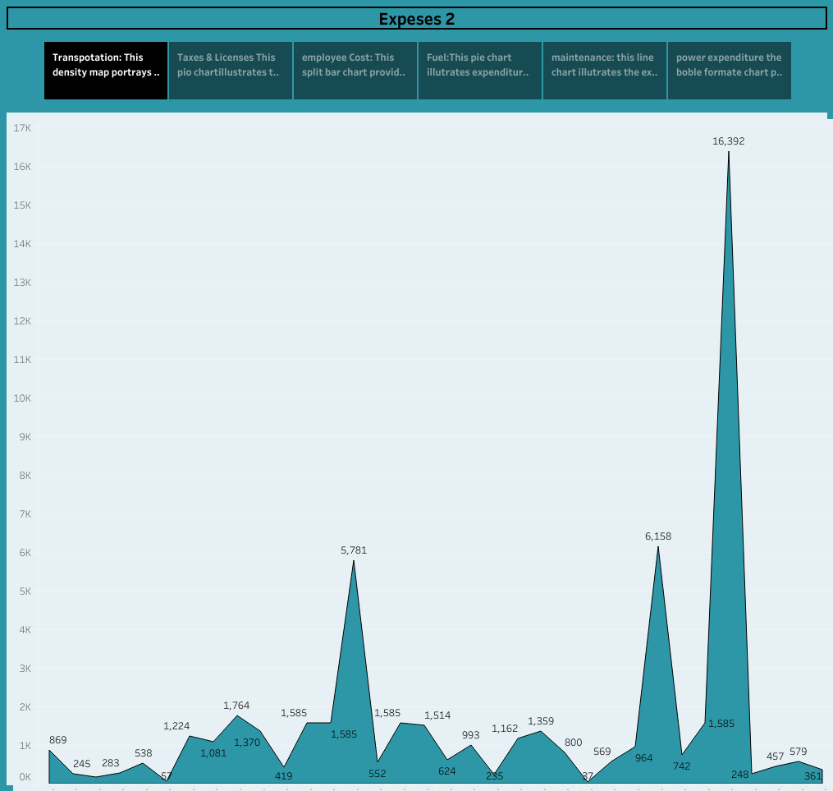

Slide 10
4. Advantages
Cost advantage is a term that refers to the competitive edge a company can gain in its market related to cost. This can include offering lower prices for the same goods or earning more profits by having lower production costs. Larger companies typically have the cost advantage over smaller companies, as they may produce more and benefit from purchasing their materials in bulk. Some businesses or companies may even own the production companies that create their materials, further increasing their cost advantage.
These are some of the areas in which companies may adjust spending to improve their cost advantage:

Slide 11
Material cost: Organizations experience a cost advantage when their products cost less to make because they can obtain the necessary materials at a lower price than their competitors.
Processes: When companies use processes that increase efficiency, reduce errors and decrease the overall time for production, they can produce more and spend less while doing so.
Distribution: A business can increase its cost advantage by reducing its distribution costs. They can do this by using new technology or implementing more efficient systems.
Management: A dedicated and skilled management system that focuses on improving a company's cost advantage can oversee other aspects like material cost, processes, distribution, automation and patents.
Automation: Using technology to automate parts of the production, distribution, sales or marketing processes can decrease costs and increase a company's overall cost advantage.
Patents: Owning the patent to technology, materials or processes can increase a company's cost advantage by giving them specific advantages that their competitors can't have.

Slide 12
Disadvantages
Disadvantages of Incorporation
Formalities and Expenses
Corporate Disclosure
Separation of control from ownership
Greater Social Responsibility
Greater Tax Burden in Certain Cases
Detailed Winding Up Procedure
1. Tax Burden
2. Social Responsibility
3.Corporate disclosures
4. Formalities and expenses

Slide 13
5. Applications
Business Applications
A business application is a collection of components that provides a business functionality that you can use internally, externally, or with other business applications. You can create business applications of individual components, which are related to each other.
For example, Order Management, Inventory Management, and Billing are business applications that might use individual components such as a Java EE application server, LDAP, and a database that runs on the Solaris server.
Business application is a type of a custom collection. You can also create the following types of custom collections:Collection, which is a group of any resources that you can select according to your needs.
Access collection, which is a collection that is used to control the access to configuration items (CIs) and permissions to modify configuration items. You can create access collections only when data-level security is enabled.
The following methods are provided for creating business applications:By using grouping patterns in Data Management Portal.
By using application descriptors.
By using grouping patterns that are created with Java API and loaded by the bulk load program.

Slide 14
6. Importance
As a business owner or entrepreneur, you know that managing your finances is crucial for success. Keeping track of your expenses is not just about balancing the books at the end of the year; it’s also about making sure that you have enough cash flow to keep your business running smoothly. In this blog post, we’ll discuss why keeping up with business expenses is important and how it can benefit you in the long run. So buckle up and get ready to learn all about procurement and how it can help your business thrive!

Slide 15
7. Conclusion
To sum up, keeping track of business expenses is an essential aspect of running a successful company. It helps you to make informed financial decisions and stay on top of your cash flow. Neglecting this important task can lead to serious consequences, such as legal penalties and potential bankruptcy. . By implementing best practices for tracking business expenses, such as regularly reviewing receipts and invoices, setting up automatic expense tracking systems, and seeking the advice of accounting professionals when necessary, you can ensure that your business stays financially healthy.

Slide 16
In today’s competitive procurement landscape, it’s more important than ever to maintain accurate records of all your expenditures. By doing so, you’ll be able to identify areas where cost-cutting measures may be needed while also ensuring that you’re staying compliant with relevant regulations.
Remember: every penny counts when it comes to managing your finances effectively. So take charge of your company’s expenses today – the long-term benefits are sure to outweigh any short-term effort required!

